Slide 1

HealthTech Supermode challenge
Ideas and innovations that solve real healthcare in Aged care and rural Care problems and have global potential

Slide 2
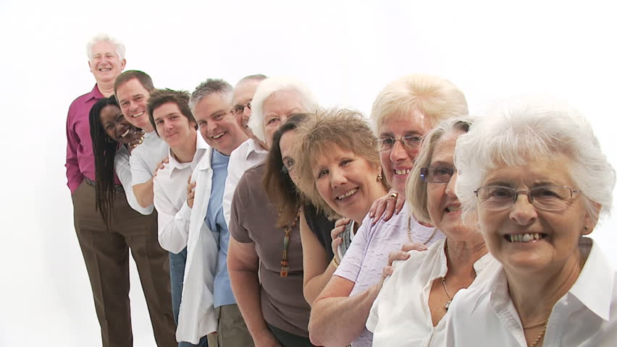
Population ageing
Between 2006 – 2013 number of people 65+ increased 22.5%; and12.1% of this group were 85+ (“old old”). By 2038, those 65+ is projected to more than double.
The proportion of the overall population 65+ is also increasing. In 1981 9.9% of the population was 65+; in 2013 the proportion was14.3%.
It is projected that the proportion of the population 65+ in 2063 will be 26.7%.
Rate of suicide in the 65+ (esp. 85+) are high a little know fact

Slide 3
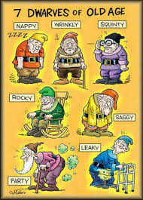
Common issues facing older people
Ageism - Negative attitudes
Seen as struggling because you are viewed as old rather than because you are lonely, unwell…
Lower expectations because you are viewed as old…to be safe you need to be in a ‘special’ community
Being treated differently because you are viewed as old - having violence and abuse treated as a health issue rather than a crime…
Notes:
Physical signs of health and wellbeing are visible but the impact of these tend to be overlooked

Slide 4
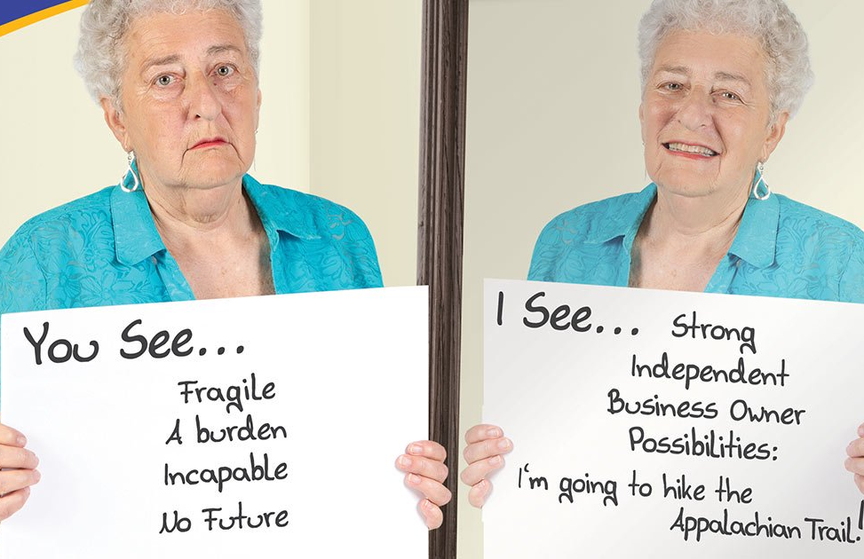
What people see…….

Slide 5
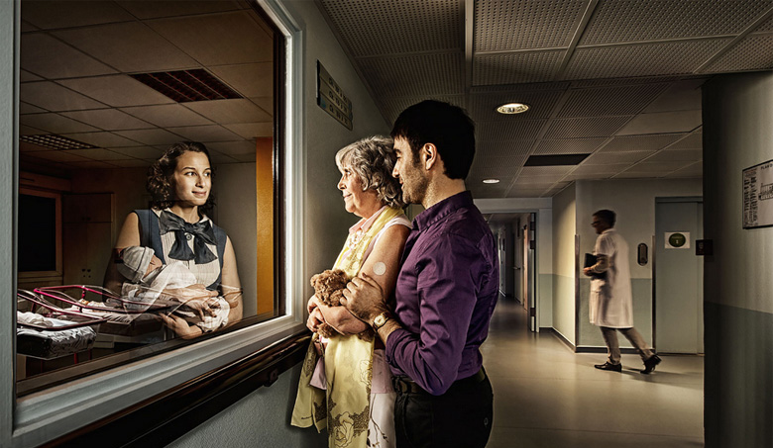
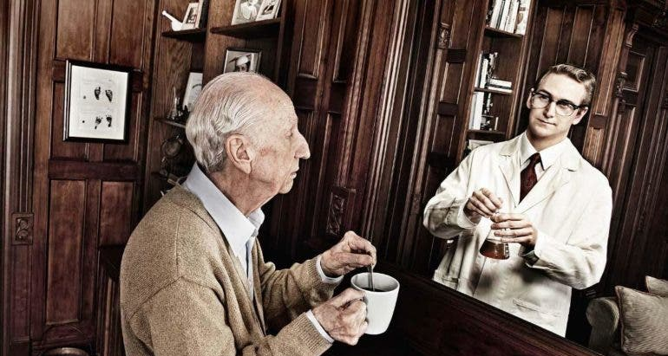
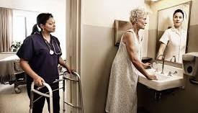
Maintaining dignity, rights , self-respect and a sense of self worth
Having passed successes, abilities and identity forgotten

Slide 6

Needs expressed by older people:
Want:
to be a citizen with the same rights/ responsibilities and opportunities as everyone else
to be listened to, consulted and heard
agency to make choices
companionship
meaning and purpose
Challenges to having these needs met:
Old age is a constructed as a medical problem
Lack of meaningful engagement
Reduced income, increased risk of poverty, increased costs (medical/insurance)
Loss of connection, sense of isolation
Loss of partner, loneliness
Physical (mobility/falls etc.) and cognitive (depression/suicide, dementia) decline, and mental health concerns – that challenges activities of daily living - Walking the dog, taking out the bins, bringing the firewood, shopping and meals, changing the light bulb, attending to the smoke alarm, having a conversation etc
Family violence and response to violence

Slide 7
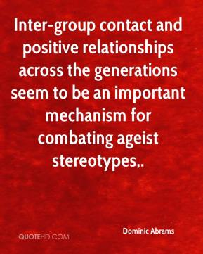
https://www.youtube.com/watch?v=13_rJVvxx_g
https://www.youtube.com/watch?v=dZ28jLkpFXI
https://www.youtube.com/watch?v=PZgGb4p0xo0
And meeting some of the needs of older people as expressed by them

